Slide 1
Introduction to Data Structure Session 02
Course : Data Structures
Effective Period : December 2018

Slide 2
Learning Outcomes
At the end of this session, students will be able to:
LO 1: Explain the concept of data structures and its usage in Computer Science

Slide 3
Outline
Abstract Data Type
Struct
Nested Struct
Array of Struct
Data Structure
Types of Data Structure

Slide 4
Data Type
Data Type is a collection of objects and a set of operations that act on those objects.
For example, the data type int consists of:
objects : 0, +1, -1, +2, -2, etc
operations : +, -, *, /, %, etc
Example of predefined data types are int, char, float.

Slide 5
Abstract Data Type
Abstract Data Type (ADT) is an example of user-defined data types.
ADT is a collection of objects and a set of operations that act on those objects.
C/C++ has a concept called class and struct which assist the programmer in implementing abstract data type.
The implementation view of an ADT is called a data structure.

Slide 6
Example of ADT
Supposed we want to create an ADT of natural number which has integer number as objects and several functions as operation.
structure Number is
objects : an integer x
functions :
bool is_zero() if ( x == 0 ) return TRUE else return FALSE
bool equal(y) if ( x == y ) return TRUE else return FALSE
void set(y) x = y
void add(y) x = x + y
int get () return x

Slide 7
Implementation of ADT: Struct

Slide 8
Structure
Structure is basically a user-defined data type that can store related information (even of different data types) together, while an array can store only entities of same data types.
It is a collection of variables under a single name.
The variables within a structure are of different data types and each has a name that is used to select it from the structure.

Slide 9
Structure Declaration
structure name
struct tdata {
int age;
char name[100];
float score;
};
structure member
don’t forget a semicolon here!

Slide 10
Structure Declaration
struct tdata {
int age;
char name[100];
float score;
};
The code above defines a structure named tdata which has three members: age (int), name (char[]) and score (float).
Creating a variable of structure is similar to create a variable of primitive data type.
tdata x; // a variable of tdata
tdata arr[100]; // an array of tdata

Slide 11
Structure Declaration
You also can define a structure as well as declare variables.
The code on the left is equal to:
struct tdata {
int age;
char name[100];
float score;
};
tdata a;
tdata b;
struct tdata {
int age;
char name[100];
float score;
} a, b;

Slide 12
Structure Assignments
You can use operator . (dot) to access member of x
tdata x;
x.age = 17;
strcpy(x.name, “andi”);
x.score = 82.5;

Slide 13
Nested Structure
You also can have a structure as a member of another structure
struct profile {
int age;
char name[100];
};
struct student {
struct profile p;
int score;
char grade; };
student x;
x.score = 92;
x.grade = ‘A’;
x.p.age = 20;
strcpy(x.p.name,”budi”);

Slide 14
Array of Structure
You also can have an array of structure.
struct profile {
int age;
char name[100];
};
struct student {
struct profile p;
int score;
char grade; };
student arr[10];
arr[0].score = 92;
arr[0].grade = ‘A’;
arr[0].p.age = 20;
strcpy(arr[0].p.name,”budi”);
arr[1].score = 83;
arr[1].grade = ‘b’;
arr[1].p.age = 19;
strcpy(arr[1].p.name,”chandra”);

Slide 15
Data Structure

Slide 16
Data Structure
A data structure is an arrangement of data, either in the computer’s memory or on the disk storage.
Some common examples of data structures include:
Arrays
Linked lists
Queues
Stacks
Binary trees
Hash tables

Slide 17
Data Structures
Data Structures can further be classified as linear data structures and non-linear data structures.
Linear data structures include structures such as: linear lists (we discussed it in previous session – Array), Stacks, and Queues where data is stored contiguously
Non Linear data structures include structures such as tree and graphs where data need not to be stored in a contiguous manner

Slide 18

Types of Data Structure
Arrays
A collection of similar data elements
Data elements have the same data type

Slide 19
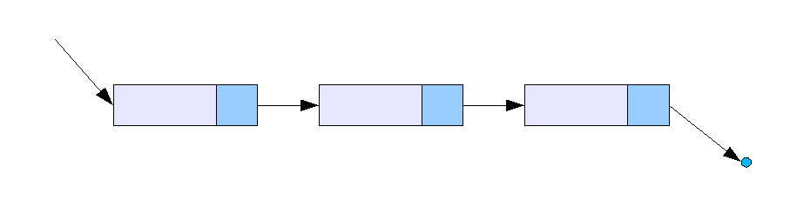
Types of Data Structure
Linked Lists
A very dynamic data structure in which the elements can be added to or deleted from anywhere at will
Each element is called a node

Slide 20

Types of Data Structure
Queue
The element that was inserted first is the first one to be taken out
The elements in a queue are added at one end called the rear and removed from the other end called the front

Slide 21
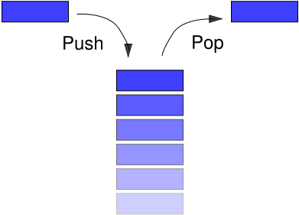
Types of Data Structure
Stacks
Stacks can be represented as a linear array
Every stack has a variable TOP associated with it
LIFO (Last In First Out) / FILO (First In Last Out)

Slide 22
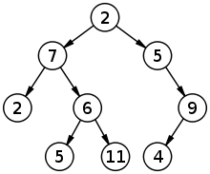
Types of Data Structure
Binary Trees
A data structure which is defined as a collection of elements called the nodes
Every node contains a left pointer, a right pointer, and a data element

Slide 23
Summary
A data structure is an arrangement of data, either in the computer’s memory or on the disk storage
Some common examples of data structures include: arrays, linked lists, queues, stacks, binary trees, hash tables
Abstract Data Type (ADT) is a data type that is organized in such a way that the specification of the objects and the specification of the operations on the objects is separated from the representation of the objects and the implementation of the operations

Slide 24
References
S. Sridhar. 2015. Design and Analysis of Algorithms. Oxford University Press. New Delhi. ISBN: 9780198093695. Chapter 5
Reema Thareja. 2014. Data structures using C. Oxford University Press. New Delhi. ISBN:9780198099307. Chapter 2 & 5
Structures In C, http://www.asic-world.com/scripting/structs_c.html

